Slide 1
Full-time, u.s. based, Data Science Salaries from 2020-2023
Joshlyn Jamerson
​
Notes:
Good afternoon,
My name is Joshlyn Jamerson, and this presentation is going to cover information about full-time, U.S. based, data science salaries from 2020-2023.
I chose this topic, mainly because I’m nosy, and I love knowing what other people make. No but seriously, I thought this was a great dataset since everyone in this zoom room has some interest in this topic.
Many of us will pursue a data science career after the military, so it’s beneficial to understand what the current market standards are in the data science field.

Slide 2
Stakeholder Interest
Fair compensation
Negotiating power
Career planning
Transparency and equity
Notes:
Now I’m going to cover the stakeholder interest.
Wage information allows for those in search of a job to know what to expect from an employer.
Understanding the threshold for fair compensation is super important. It allows employees to know what is a fair wage for certain positions and skill levels. This information can ensure they are being fairly compensated for their skills, experience, and contributions.
This data can help individuals make informed decisions about career paths, job changes, and skill development to maximize their earning potential.
Additionally, access to salary information promotes transparency within organizations and across industries.

Slide 3
Agenda
Highest Paid Jobs
Lowest Paid Jobs
Most Popular Jobs and their Average Pay
How does experience level relate to pay
Remote work
Ratio to company size
Notes:
The questions I will be answering are as follows:
What are the highest paid jobs in the data science field?
What are the lowest paid jobs?
What are the most popular jobs and the average pay for these positions?
Does experience level relate to pay?
Does company size relate supporting remote positions?

Slide 4
DATA wrangling
Removed Data From Other Countries
Including Employee Residency
Company Location
Full Time Employee Data Only
Kept duplicate rows
Notes:
This dataset contained information about companies that were not located in the U.S. For the purpose of my analysis, I excluded those and only focused on U.S. based companies.
This dataset also contained information about multiple types of employees. I removed all data that was not related to full time employees.
This dataset had over 1,000 duplicate rows. I reviewed the duplicates and decided that it was likely and logical for there to be multiple occurrences of the entries.

Slide 5
COLUMNS OF INTEREST
Job Title
Salary in USD
Employment Type
Company Location
Experience Level
Remote Ratio
Company Size
Employee Residence
Notes:
For the purpose of my analysis, I am focusing on the following columns: job title, salary in USD, employment type, company location, experience level, remote ratio, and company size.
The other columns in this dataset included work year, salary, and salary currency.

Slide 6
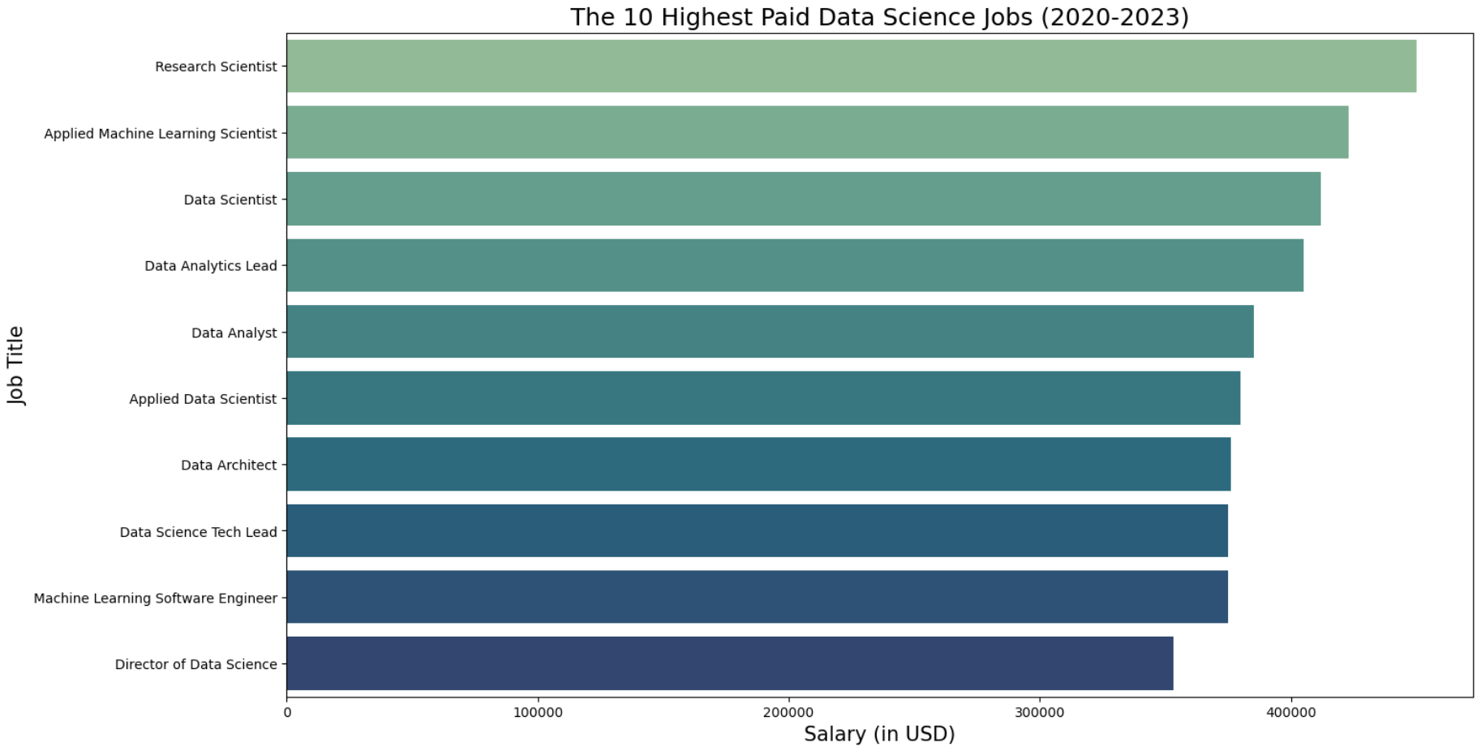
Notes:
This chart shows the top 10 highest paid data science jobs. The range is from a Research Scientist with the salary of 450,000 dollars to a Director of Data Science with the salary of 353,000 dollars.

Slide 7
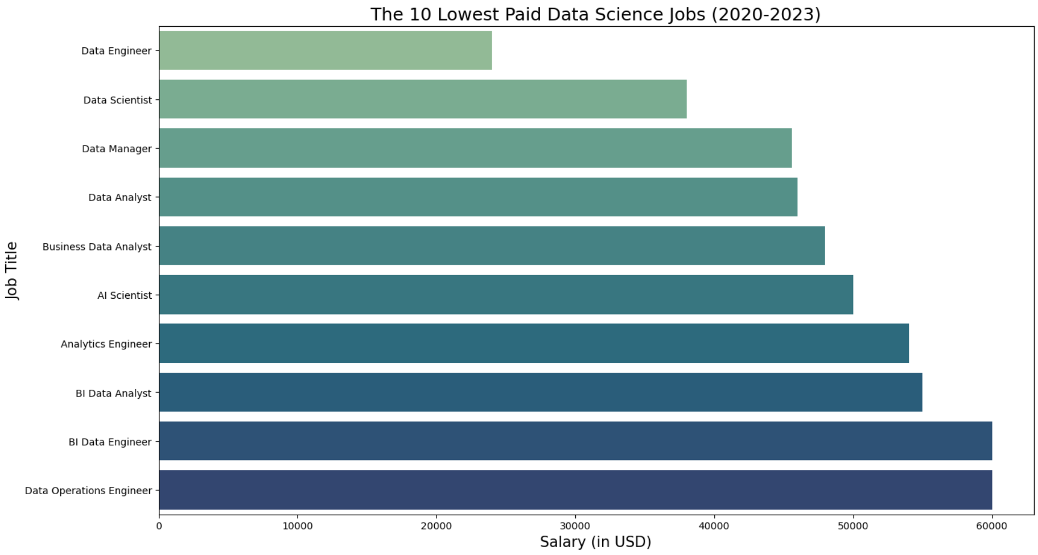
Notes:
On the other end, the range is from the Business Intelligence Data Engineer with 24,000 through the Data Operations Engineer and Business Intelligence Engineer at 60,000.

Slide 8
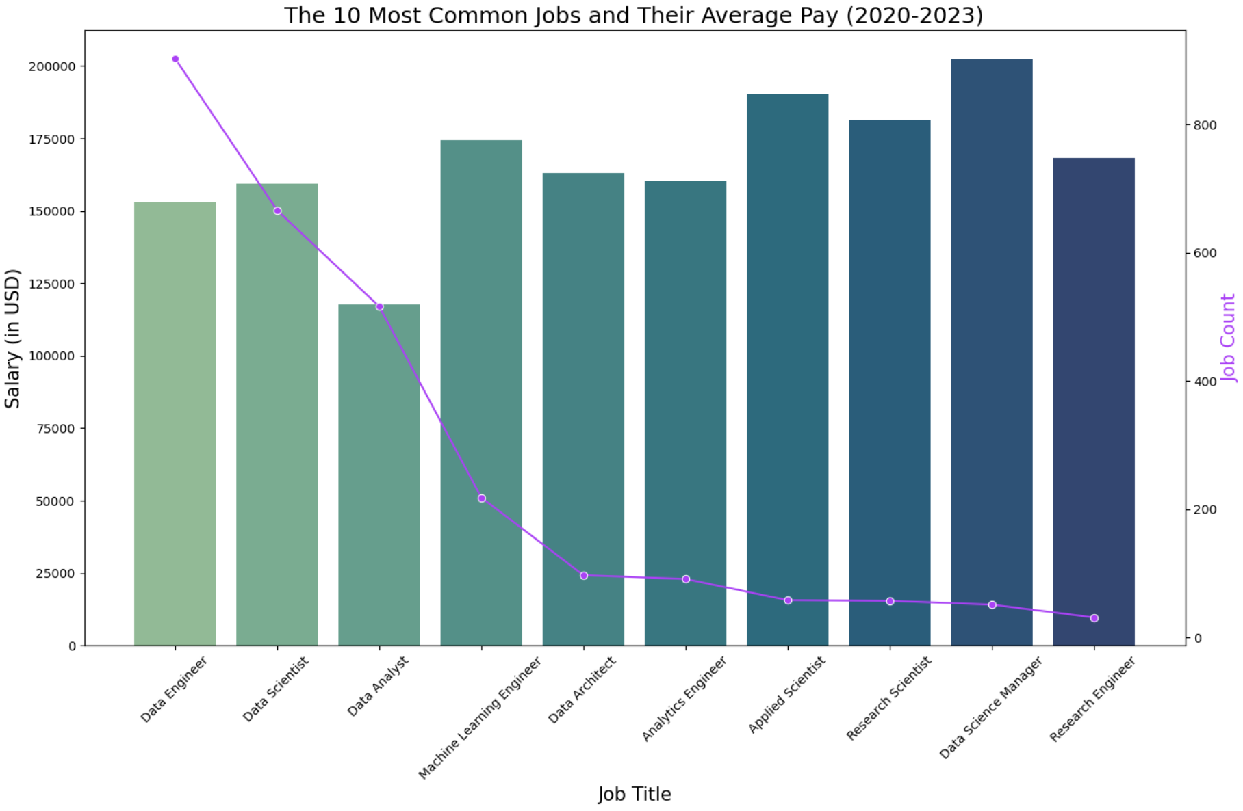
Notes:
This graph displays the most common jobs and their average pay. The left y axis shows the salary in USD and the right y axis shows the overall job count for the position.
The most common position in this dataset was a data engineer with an average salary of just over 153,000 dollars.

Slide 9
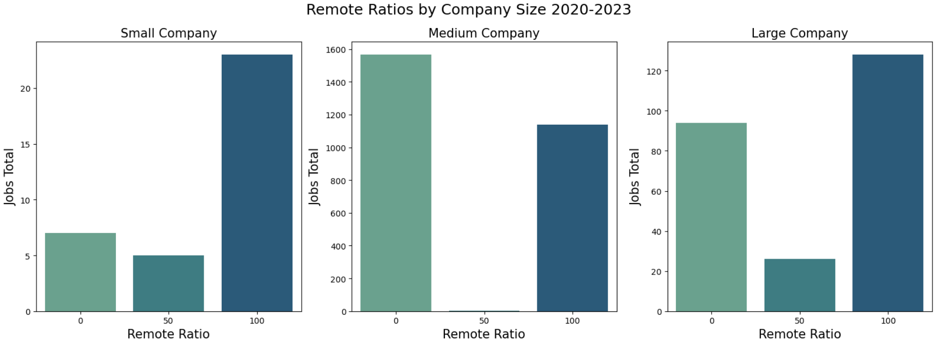
Notes:
To give you all some background on this dataset,
In terms of company sizes, small company is defined as a company with 500 employees or less
Medium Company is defined as companies with 500-1000 employees.
Large companies is defined as companies with 1000+ employees.
Each graph shows the remote ratio by company size and split up into 3 categories: in person only which is 0%, hybrid which is 50%, and fully remote jobs which is 100%.
Small companies had the least amount of in person jobs and mainly offered remote work.
Surprisingly, medium companies had the highest amount of in person jobs and very little hybrid work offered.
Large companies had the most variance with mainly in person work, a high amount of remote work, and hybrid options.

Slide 10
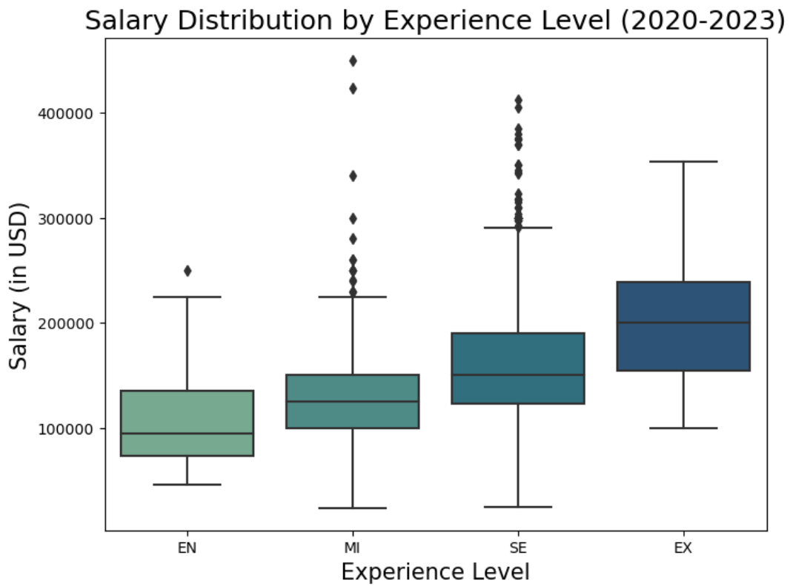
Notes:
This boxplot shows the salary distribution by experience level.
The whiskers are the minimum and maximum values. The line within the box is the median and the box itself shows the lower quartile and upper quartile ranges. Anything plotted outside of the whiskers are outliers.
As I expected, entry level jobs typically tend to be the lowest paid, followed by mid-level, senior level, and executive level. There are the most outliers with mid-level and senior level jobs.

Slide 11
Future project plans
Analysis on companies located outside of the U.S
Analysis on employees residing outside of the U.S.
Analysis on part-time, contract, and freelance salaries
Information from other sources besides this dataset
Notes:
If I had more time, I would be interested in doing analysis on companies that are located outside of the U.S.
I would also be interested in looking into doing some comparison between employees pay who are located in the U.S. versus outside of the U.S.
It would be beneficial to look at other employment types besides just full time.
I would also like to look at other sources to compare the information in this dataset versus others to see how they vary.

Slide 12
Q&a/Contact info
Joshlyn Jamerson
Joshlyn.Jamerson@spaceforce.mil
Original dataset: https://www.kaggle.com/datasets/arnabchaki/data-science-salaries-2023
Github Repository: https://github.com/joshlynj/ds_salaries
Notes:
Here how you can contact me or get more information about this dataset or my project.
Are there any questions?

Slide 13
Work year breakout
work_year 3022 non-null int64 1 experience_level 3022 non-null object 2 employment_type 3022 non-null object 3 job_title 3022 non-null object 4 salary 3022 non-null int64 5 salary_currency 3022 non-null object 6 salary_in_usd 3022 non-null int64 7 employee_residence 3022 non-null object 8 remote_ratio 3022 non-null int64 9 company_location 3022 non-null object 10 company_size 3022 non-null object
2023 1563
2022 1320
2021 83
2020 25

